Slide 1
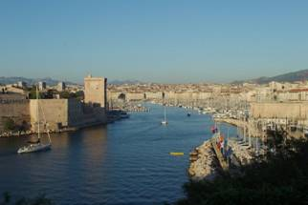
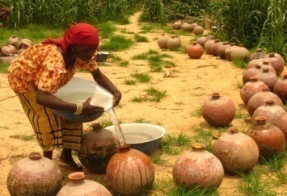
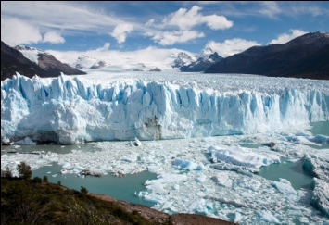
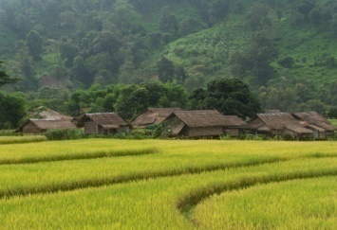
TOWARDS WORLD WATER SOLUTIONS
WWC Members meeting – Marseille, France Jun 8, 2011
Forum Symposium: North
American Regional EventWorkshop Nov 27, 2010
6th World Water Forum
March 2012, Marseille
Benedito Braga
Vice-President of the World Water Council
Professor of Civil and Environmental Engineering – University of Sao Paulo
President, International Forum Committee

Slide 2
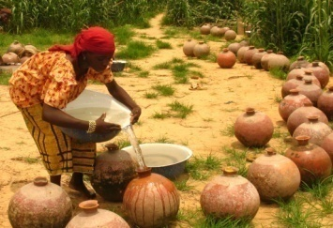
THE WORLD WATER COUNCIL
International organization created in 1995 based in Marseille, France.
A voice for the international water community, representing all stakeholders and sectors
Gathers nearly 400 member organizations from approximately 70 countries
Think-Tank for the development of global water resources policies – Water Policy Journal
Organizes the World Water Forum every 3 years in partnership with a host country and city:
Marrakech in 1997
The Hague in 2000
Kyoto in 2003
Mexico in 2006
Istanbul in 2009

Slide 3
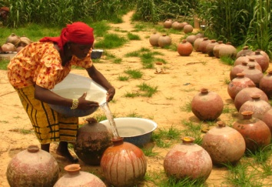
THE WORLD WATER FORUM
The world’s largest water event
Objectives:
Gather all stakeholders together to debate questions related to water, its management and access
Formulate concrete proposals and encourage action and solutions
Solicit true and lasting political commitment
A platform for debates and exchange on questions that are relevant for improved water resources management and access to water supply and sanitation
An open and constructive place for discusssion

Slide 4
FACTS AND FIGURES FROM ISTANBUL
Over 25,000 participants
192 countries represented
1,300 participants in the political processes
106 sessions prepared by over 400 organizations
150 side events
Over 1,000 accredited journalists
135 children from over 20 countries and over 200 youth participants
1,000 sponsored participants

Slide 5
THE 6TH WORLD WATER FORUM
In Marseille 12 – 17 March 2012
Organizers:
France, represented by the Ministry of Foreign and European Affairs, the Ministry of Ecology and the City of Marseille
The World Water Council
France and Marseille
Strong political commitment
A candidature combining energy from the local level to the highest decision-making level
Highlighting specific capacities and a water culture
A strong will to federate all stakeholders and encourage action

Slide 6
TIME FOR SOLUTIONS
Prefering action over theoretical discourse and debates
Encouraging lasting concrete commitments through a follow-up mechanism
Involving wide participation of stakeholders including those outside the « water box »
Creating true mobilization of citizens in a friendly, festive and popular atmosphere

Slide 7
Towards concrete solutions !
The Process
THEME
ISSUES
PRIORITIES
TARGET
SOLUTION

Slide 8
SMART TARGETS AND WISE PROCESS
SMART focuses on the relevance of the targets
Specific
Measurable
Achievable
Realistic
Time bound
WISE focuses on the process
Wide Involvement Stakeholder Exchanges

Slide 9
A FORUM FOR THE CAUSE OF WATER
Solutions are first and foremost of a political nature and must be found by reinforcing dialogue between:
Governments
Parliamentarians
Local Authorities
Intergovernmental Organisations / United Nations
NGOs / Civil Society / Users
Professionals / Scientists / Experts
Public and Private Companies

Slide 10
ORGANIZATIONAL STRUCTURE
French National Committee
World Water Council
C. Fremont
L. Fauchon
International Forum Committee – IFC
USP, IHA, USACE, UNHabitat, ASN, SEMI, MWR, ANEAS, KWF, IUCN, UNESCO
AFD, EV, MEDDM, FP2E, MFEA, ONEMA, CM, PACA, DBCHR,MMUC, CCIM
IFC Bureau
B.Braga, G. Fradin, M. Vassal and A. Szollosi-Nagy
Political Process Commission
Regional Process Commission
Thematic Process Commission
Promotion and Events Commission
P. Lacoste
A. Szollosi-Nagy
E. Park
M. Bernard
D. Altinbilek
P. Lavard
M. Vassal
H. Kennou
6th Forum Secretariat
J.P. Nicol

Slide 11
THE KICK-OFF MEETING
Officially launched the preparatory process in April 2010 in Paris and Marseille and encouraged stakeholders to contribute and engage
Communicated the central concept of the Forum and received suggestions from participants on the relevant issues and priorities
Underlined and amplified the degree of political commitment from the host city and country and the international community

Slide 12
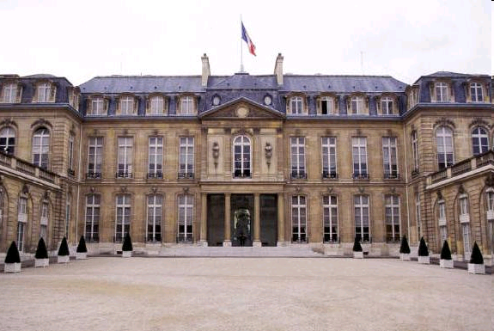

Slide 13
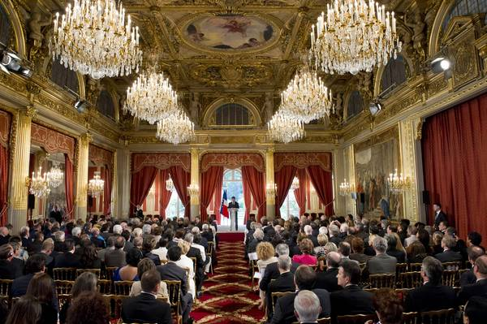

Slide 15
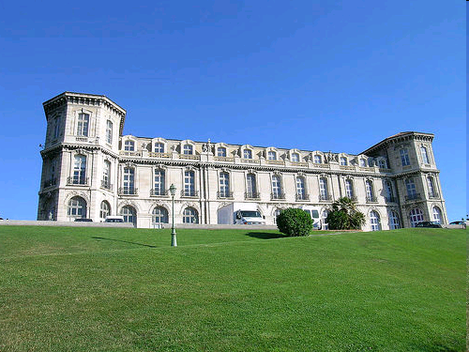

Slide 16
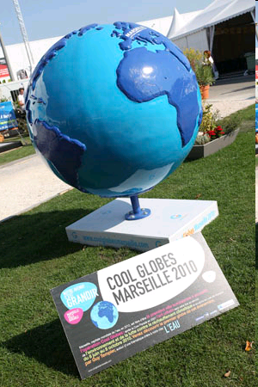

Slide 17
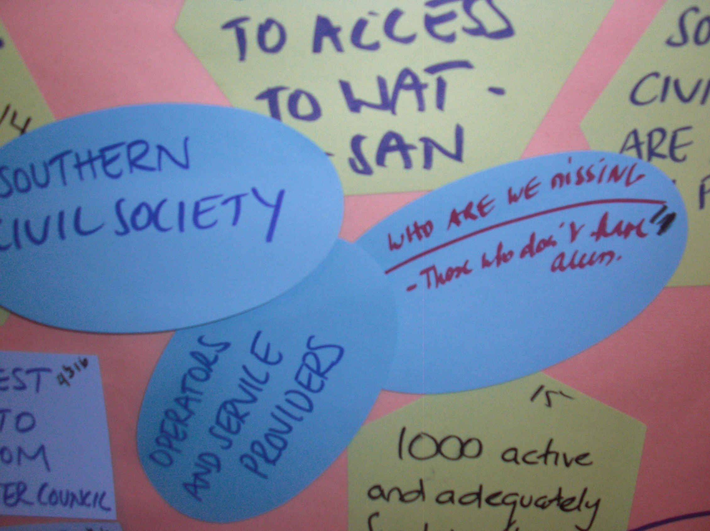

Slide 18
2nd CONSULTATION MEETING
Second consultation takes place in January 2011 in Paris with approximately 400 participants including government representatives, parliamentarians, local and regional authorities, private sector, NGO community, academia
Targets were proposed around the 12 priorities and 3 conditions for success (144 targets) to be worked and consolidated to a manageable number by the Thematic Commission
By year 20yy increase by xx% the capacity of water storages in support of irrigated agriculture (either supplementary, deficit, or full irrigation) - within the framework of an environmentally sufficient and socially sound management - ICID

Slide 19
THEMATIC PROCESS
CREATING A BLUE MOVEMENT !
3 strategic directions
12 key priorities for water action:
Guarantee access to water services for all and the Right to Water
Guarantee access to integrated sanitation services for all
Contribute to improved hygiene and health through water
Ensure everyone’s well- being
Good governance
Protect populations and economies from risks
Finance water for all
Contribute to cooperation and peace
Enabling environment
Balance multiple uses through IWRM
Contribute to economic development
Ensure food security
Harmonize energy and water
Protect and value ecosystem services and green growth
Improve the quality of water resources and ecosystems
Keep the planet blue
Adjust pressures and footprints of human activities on water
Respond to climate and global changes in an urbanizing world
Conditions
for
success

Slide 20
REGIONAL PROCESS
Coordinated by RPC under supervision of IFC Bureau
Supports RC
Implement SMART targets through WISE Processes
Report outcomes
Continental Processes
Americas
ANEAS
Asia-Pacific
JWF
Europe
OIEAU
Africa
AMCOW
S. America
SE Asia
N. America
NE Asia
Southern
Northern
C.America
S. Asia
Caribbean
C. Asia
Eastern
Cross-continental Targets may result in cross-continental processes – (Central Asia, Mediterranean and others)
Notes:
20

Slide 21
POLITICAL PROCESS
A multi-level approach:
Ministerial Process
Local Authorities Process
Parliamentarian Process
Notes:
21

Slide 22
Political Process Commission Visibility ⬄ communicate on Results
1) Build on legacy from previous
Fora / Istanbul
Assessments of results
Targets to scale up
Gaps / emerging issues
Political answers?
Result-oriented
deliverables
Thematic
Blue movement
Regional
dialogues
Local/Regional Authorities
Istanbul Consensus, champion Cities
Parliamentarians
Helpdesk for water legislations
<Water> Ministers
Declaration on challenging issues
Declaration ?

Slide 23
Political Process Commission Interact with the international agenda
Influence the agenda
Bring messages
Outcomes endorsed by UN system?
Rio+20
WHO
International
Events / fora
Climate
MGDs
Right to W&S
UNGA, HRC, UN Hab.
Marseille
2012
…
Regional
initiatives
UfM / MED
SAN-conf.
Africa WW
AWF
APWF
Bilateral
initiatives
Bonn+10
…

Slide 24
TIMETABLE OF THE FORUM PROCESS
Toward concrete, SMART & WISE solutions!
2010
2011
2012
Q3
Q4
Q1
Q2
Q3
Q4
Q1
Kick-off meeting
WWF Marseille
WISE approach for each SMART target at regional level
Thematic Process priorities and targets input
Consolidation of Targets by Region – TP & RP
2nd Prepcom meeting - PP
Invitation letters to Foreign Affair Ministries
1st Prepcom meeting - PP

Slide 25
NEXT STEPS
Engagement continues throughout 2011 - 2012
May 24, 2011 – North American Regional Event – ASCE-EWRI Palm Springs, USA
May 30 – 31, 2011 – First Local Authorities international meeting – Lyon, France
June 10, 2011 – First Parliamentarians international meeting – Estrasburg, France
3rd and 4th quarter 2011 – SWW, SIWW, Major regional events in Africa, Americas, Europe and Asia Pacific (regional targets and political involvement)
Solution’s platform www.worldwaterforum6.org
Notes:
25

Slide 26
TIME FOR SOLUTIONS
THANK YOU FOR YOUR ATTENTION
Notes:
26

